Slide 1


FinOps Services
Flairminds
Innovation, Resilience, Efficiency

Slide 2

Content
What is FinOps?
Introduction to FinOps
Potential value addition with FinOps
Flairminds’ approach:
Snapshot of strategies
Tools and technology capabilities at Flairminds
Case studies
Confidential - Work Document

Slide 3

What is FinOps?
Framework for optimizing operational expenses relation to cloud computing.
Combines DevOps and finance principles for decision making & maximize business values.
It promotes financial accountability by promoting collaboration between teams and taking ownership of cloud usage
Confidential - Work Document

Slide 4
Value addition with FinOps
Cost optimization and increased efficiency
Financial transparency and accountability
Collaboration across finance, operations and engineering
Real time and data driven insights
FinOps = Max Cloud @ Min Cost
Confidential - Work Document

Slide 5
Eliminating waste:
Under utilization of allocated resources.
Analyze usage patterns
Identify underutilized resources
Identify, reduce & right size infrastructure & wastage leading to cost optimization without affecting services.
Re-Architecting product:
We help you redesign and restructure an application or system to optimize its performance, scalability, and cost efficiency in the cloud environment.
We guide you for changes to the architecture, infrastructure, and code of product to align with cloud best practices and take advantage of cloud-native features and service
Optimizing resources:
Cost incurred for running all resources on cloud is bringing sufficient value for your business.
Continuous monitoring of resources utilization and helping you make infrastructure sizing decisions.
FinOps Strategies
Cloud commitment plan:
Optimal recommendation of cloud commitment plans to reduce overall cloud spending
We leverage this scheme by analyzing historical data of every resource and making decisions in committing an amount of resource which will maximize business value.
Choosing right services
Right service is selected for your infrastructure by considering several factors like performance, availability , budget, scalability, features and functionality intended to be implemented.
Confidential - Work Document

Slide 6




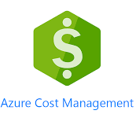

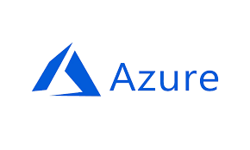

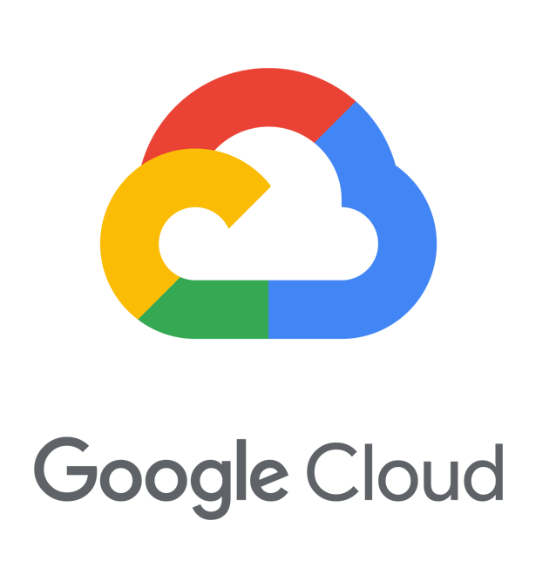
Our experience
AWS Cost Explorer, Billings, Athena, Cloudwatch
Azure cost management, Azure advisor, Azure hybrid benefits
Billing Experts, GCP native cost management
Confidential - Work Document

Slide 7




Contact
PUNE OFFICE
FlairMinds Software Pvt. Ltd. 11, Soormani, 163 D.P.Road, Aundh, Pune, opposite DAV School, 411007, India
NAGPUR OFFICE
Infosane Technologies llp Nagpur, Shop No. 168, RAJAT SANKUL Opp. S.T. Stand, Near Hotel Rahul Deluxe GANESH PETH, Nagpur, Maharashtra 441108,India
sales@flairminds.com
+91 9967 650 472
FlairMinds
Confidential - Work Document

